Slide 1
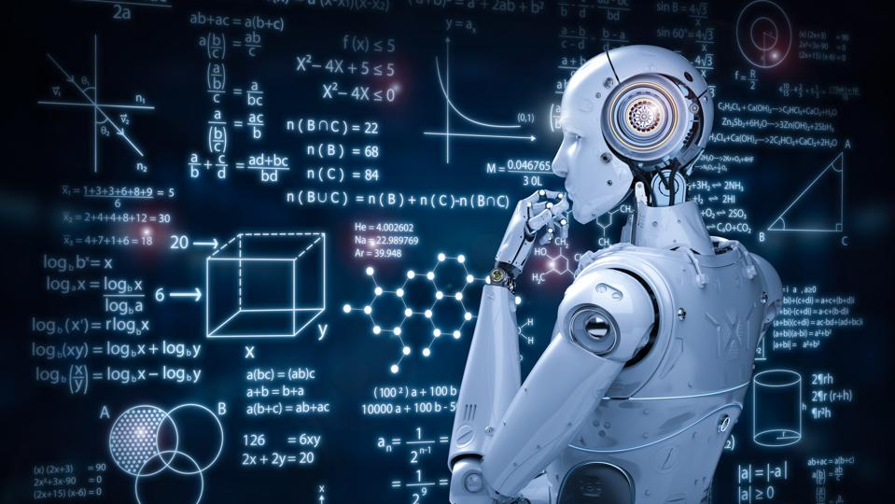

Introduction to machine learning
By,
Shradha .s. birje

Slide 2
Introduction
As we know we are living in a world of humans and machines. Humans have been evolving and learning from their past experiences since millions of years whereas the era of machines and robots have just begun.
In today’s world these machines or robots are like they need to be programmed before they actually follow your instructions but what if the machines started to learn on their own and this is where machine learning comes into picture.
Today we can see many examples or implementations of machine learning around us like Tesla self-driving cars, Apple Siri, Sofia AI robot and many more

Slide 3
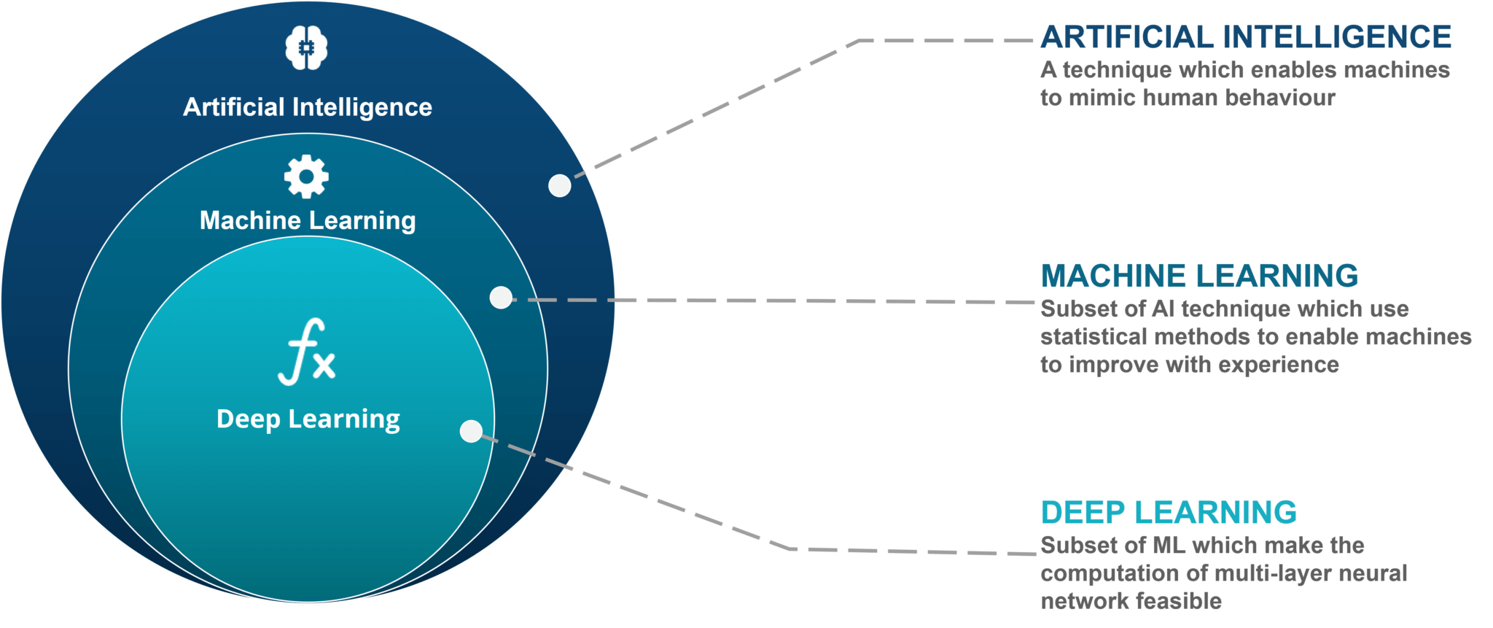
introduction
Machine Learning is a subfield of Artificial Intelligence that focuses on design of system that can learn from and make decisions and predictions based on the experience which is data in case of machines.
Machine learning enables computer to act and make data driven decisions rather than being explicitly programmed to carry out a certain task.

Slide 4
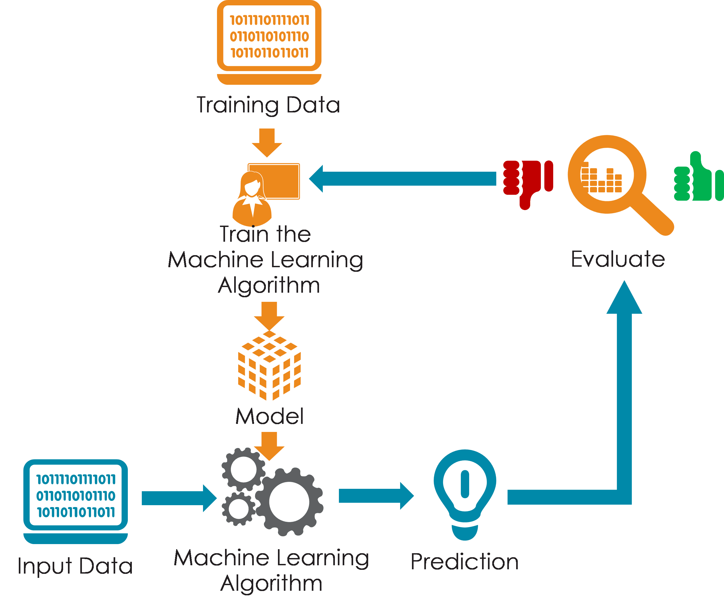
How does machine learning work?

Slide 5
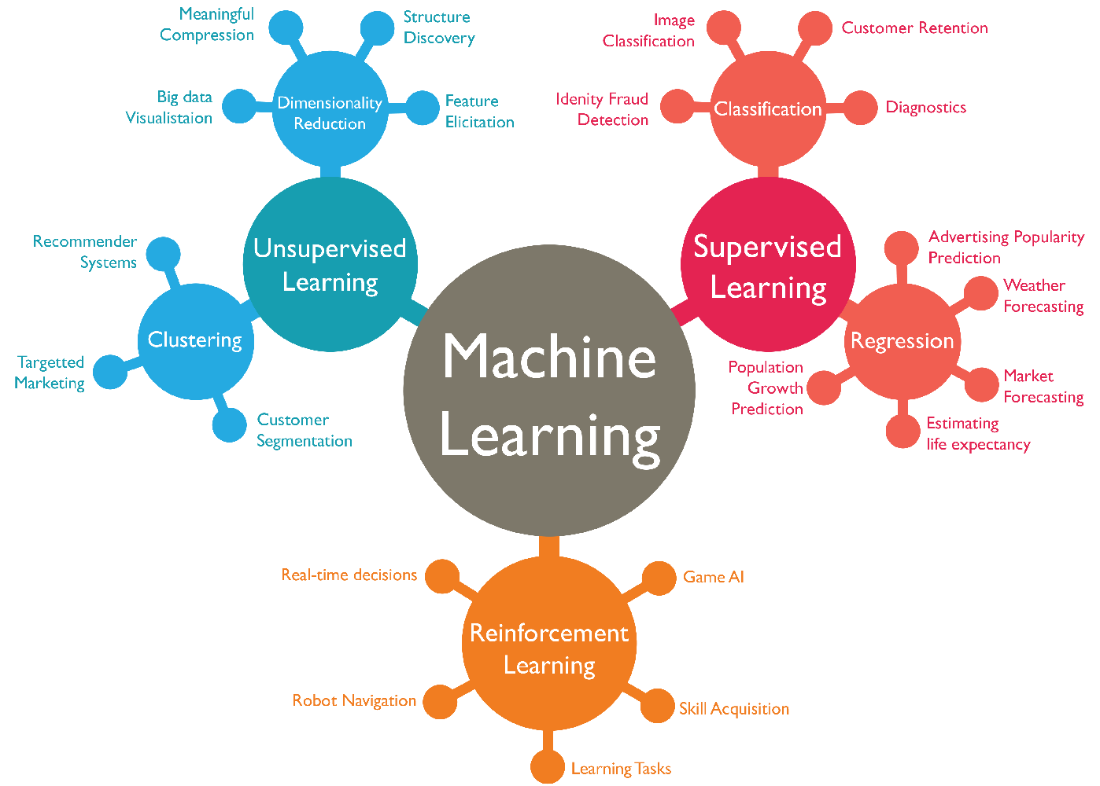
Machine learning types
SUPERVISED LEARNING
UNSUPERVISED LEARNING
REINFORCEMENT LEARNING

Slide 6
Machine learning : supervised
Suprvised learning is where you have input variables X and an output variable Y and you use an algorithm to learn the mapping function from the input to the output that is Y equals f(X).
The goal is to approximate the mapping function so well that whenever you get a new input data X you can predict the output variable Y.
This category of learning is called as supervised learning because the process of an algorithm learning from the training dataset can be thought of as a teacher supervising the learning process. If we know the correct answers the algorithm iteratively makes decisions while predicting on the training data and is corrected by the teacher.
The learning stops when the algorithm achieves an acceptable level of performance.
Example: Linear Regression,Radom Forest and Support Vector Machines
Use Cases: Cortana Speech Automation,Weather APP,Biometric

Slide 7
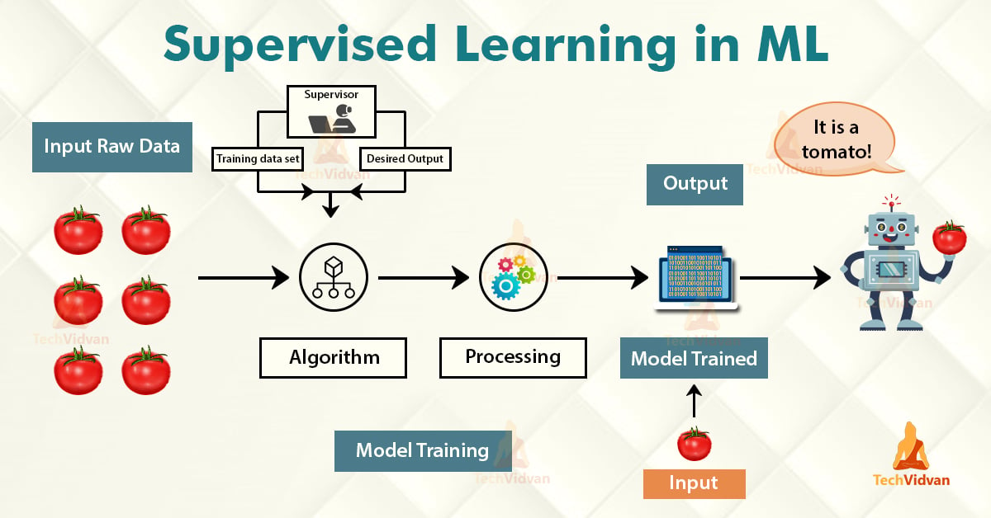
Supervised learning in machine learning

Slide 8
Machine learning : unsupervised
Mathematically unsupervised machine learning is where you have only input data set X and no corresponding output variable.
The goal of unsupervised learning is to model the underlying structure or distribution in the data in order to learn more about the data.
In Unsupervised Learning approach the data instances of a training dataset do not have an expected output associated to them instead unsupervised learning algorithm detects pattern based on init characteristics of the input data.
This category is called as unsupervised learning because unlike supervised learning ever there are no correct answers and no teacher. Algorithms are left on their own to discover and present the interesting structure in the data.
Example: Clustering in which similar data items are grouped together to identify clusters of data.
K means, Apriori algorithm and hierrarchical clustering
Use cases: People attending a party, Watching a football match.

Slide 9
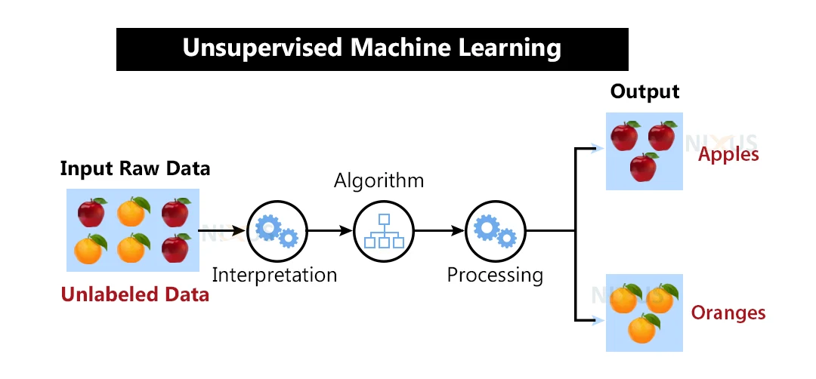
Unsupervised learning in machine learning

Slide 10
Reinforcement learning
Reinforcement learning is a type of machine learning algorithm which allows software agents and machines to automatically determine the ideal behavior within a specific context to maximize its performance.
The reinforcement learning is about interaction between two elements the environment and the learning agent.The learning agent leverages two mechanisms namely exploration and exploitation.
When learning agent acts on trial-and-error basis it is termed as exploration and when it acts based on the knowledge gained from the environment it is known as exploitation.
This environment rewards the agents for correct answers which is reinforcement signal leveraging the rewards obtained the agent improves its environment knowledge to select the next action.
Example: Pablo training his dog.
Use Cases: Banking sector-Next best offer by predictive modelling when customer accepts or rejects the offer.

Slide 11
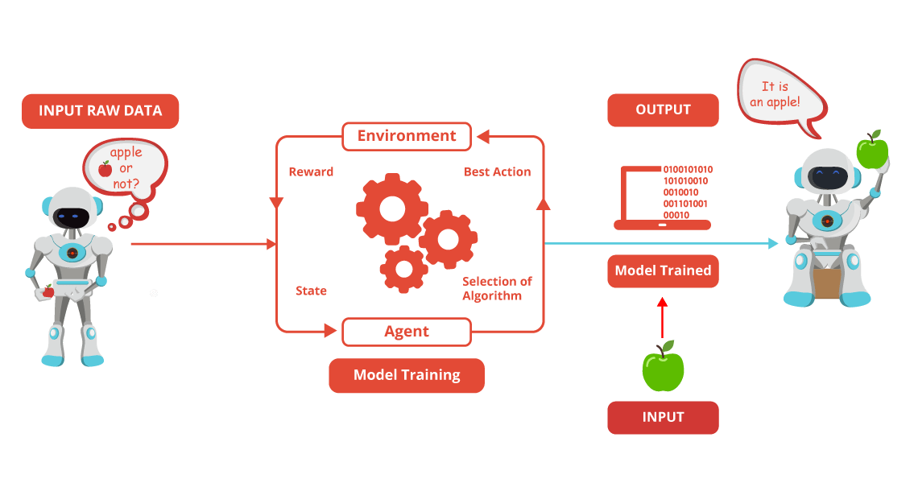
Reinforcement learning in machine learning

Slide 12
Thank you

